Slide 1
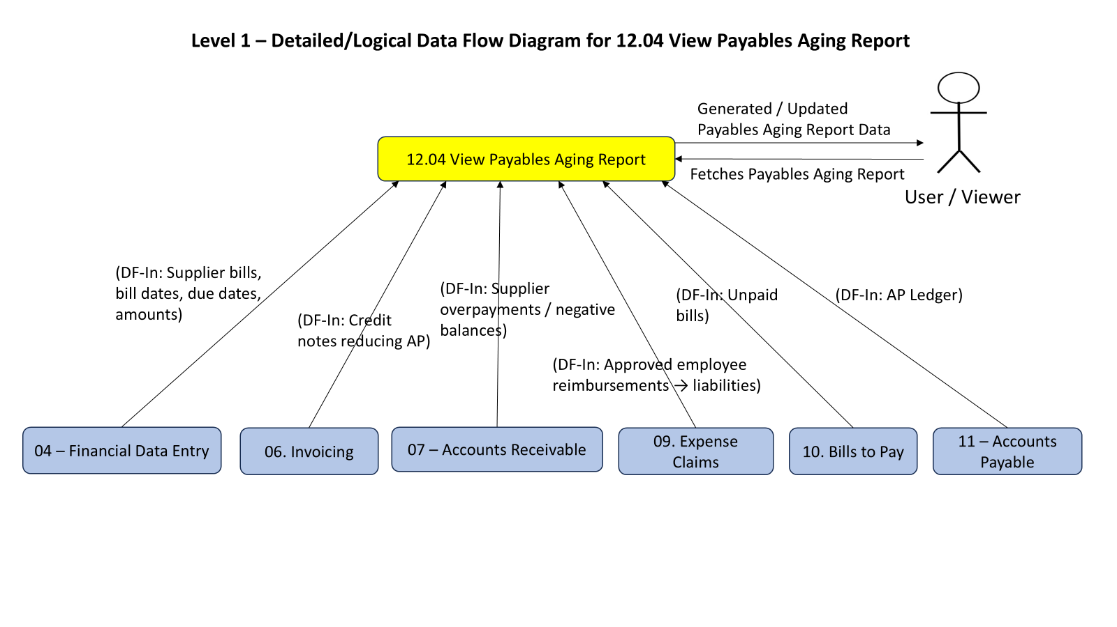

Slide 2
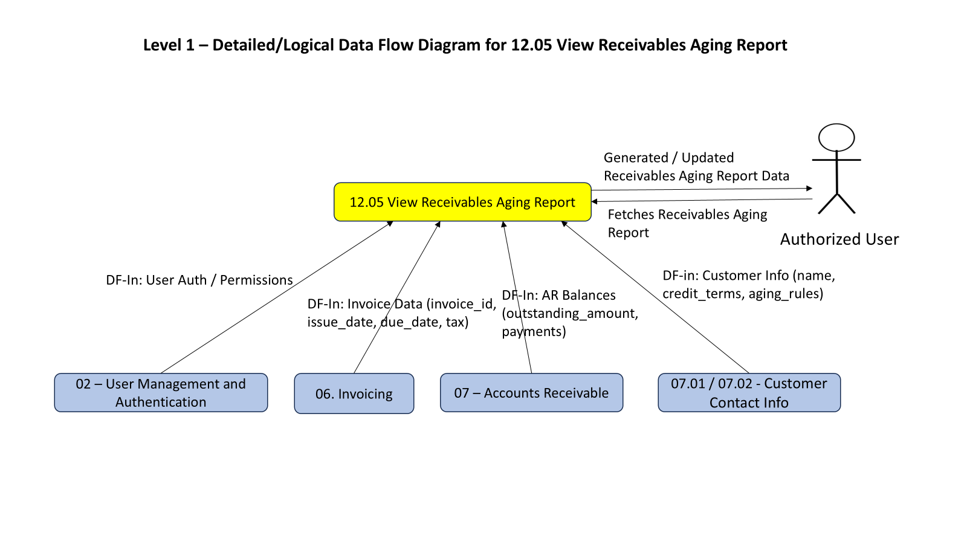

Slide 3
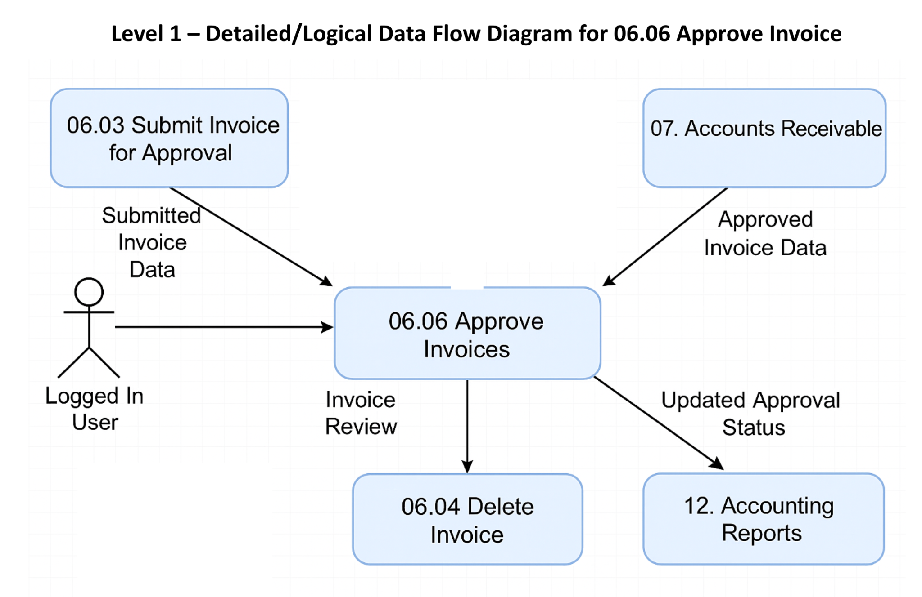

Slide 4

Level 1 – Detailed/Logical Data Flow Diagram for 06.07 Set Up Reminder
06. Invoicing (Invoice Data)
DF-In: Invoice Headers,
Due Dates, Amounts
User
06. 07 Set Up Reminders
DF-In: Contact Email, Customer Details
DF-Out: Reminder Logs,
AR Updates
Contacts (Customer Data)
DF-In: Invoice Status,
Aging Info
07. Accounts Receivable
12. Accounting Reports

Slide 5
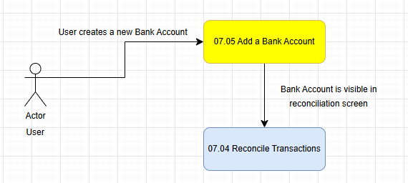
Level 1 – Detailed/Logical Data Flow Diagram for 07.05 Add a Bank Account

Slide 6
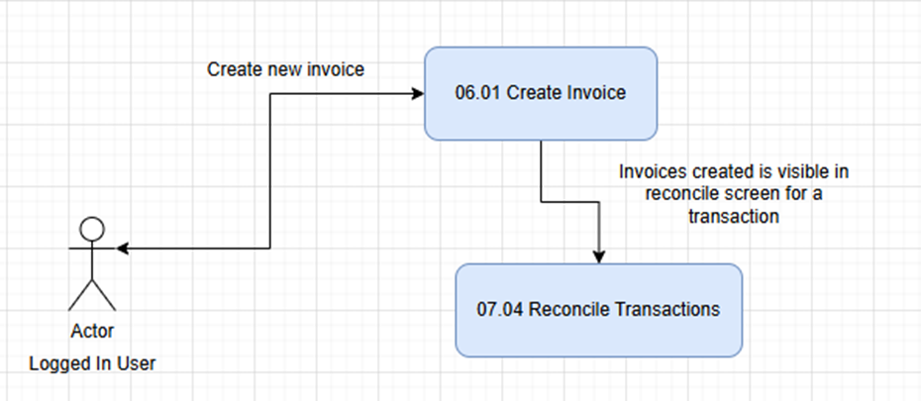
Level 1 – Detailed/Logical Data Flow Diagram for 07.04 Reconcile Transactions

Slide 7
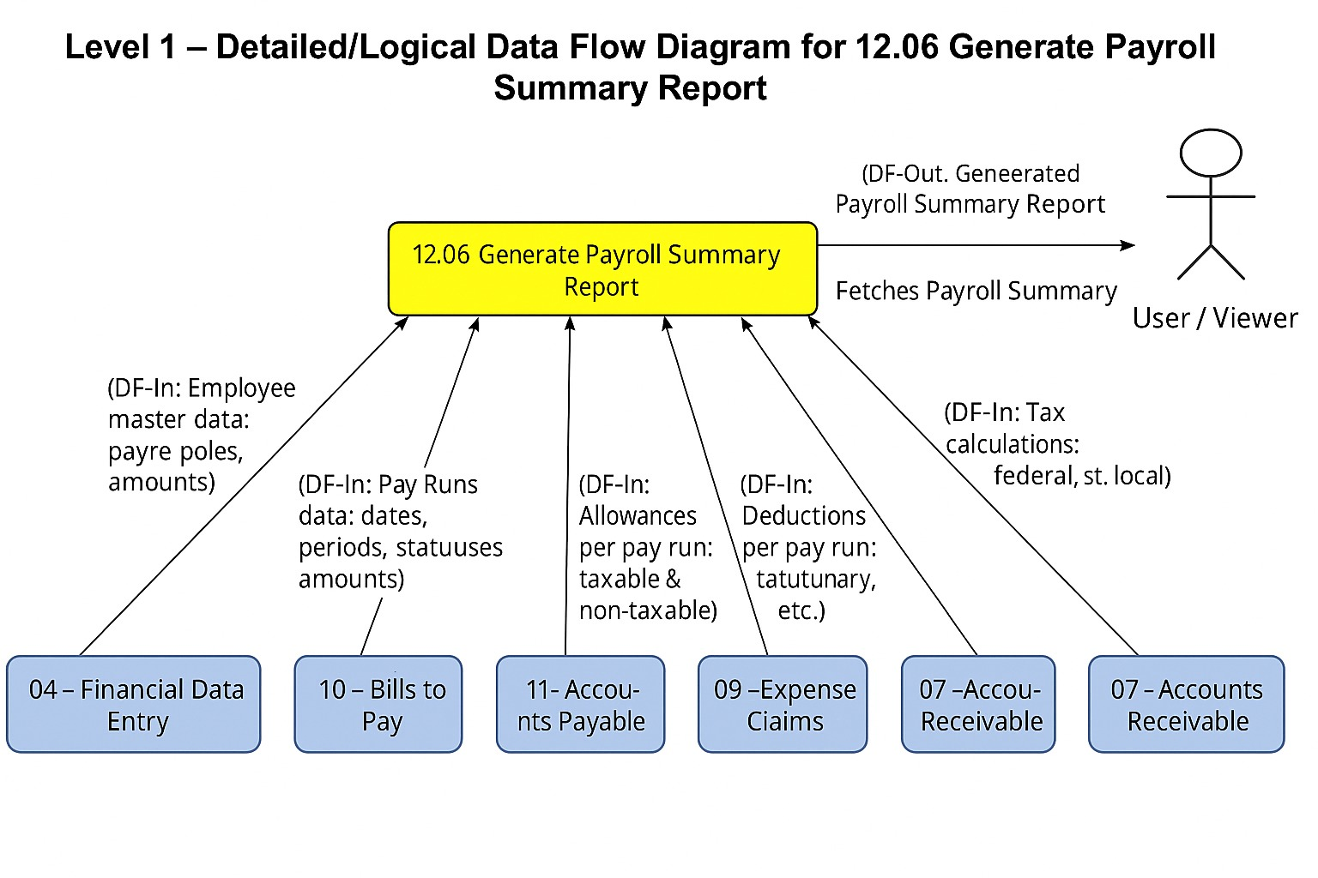

Slide 8
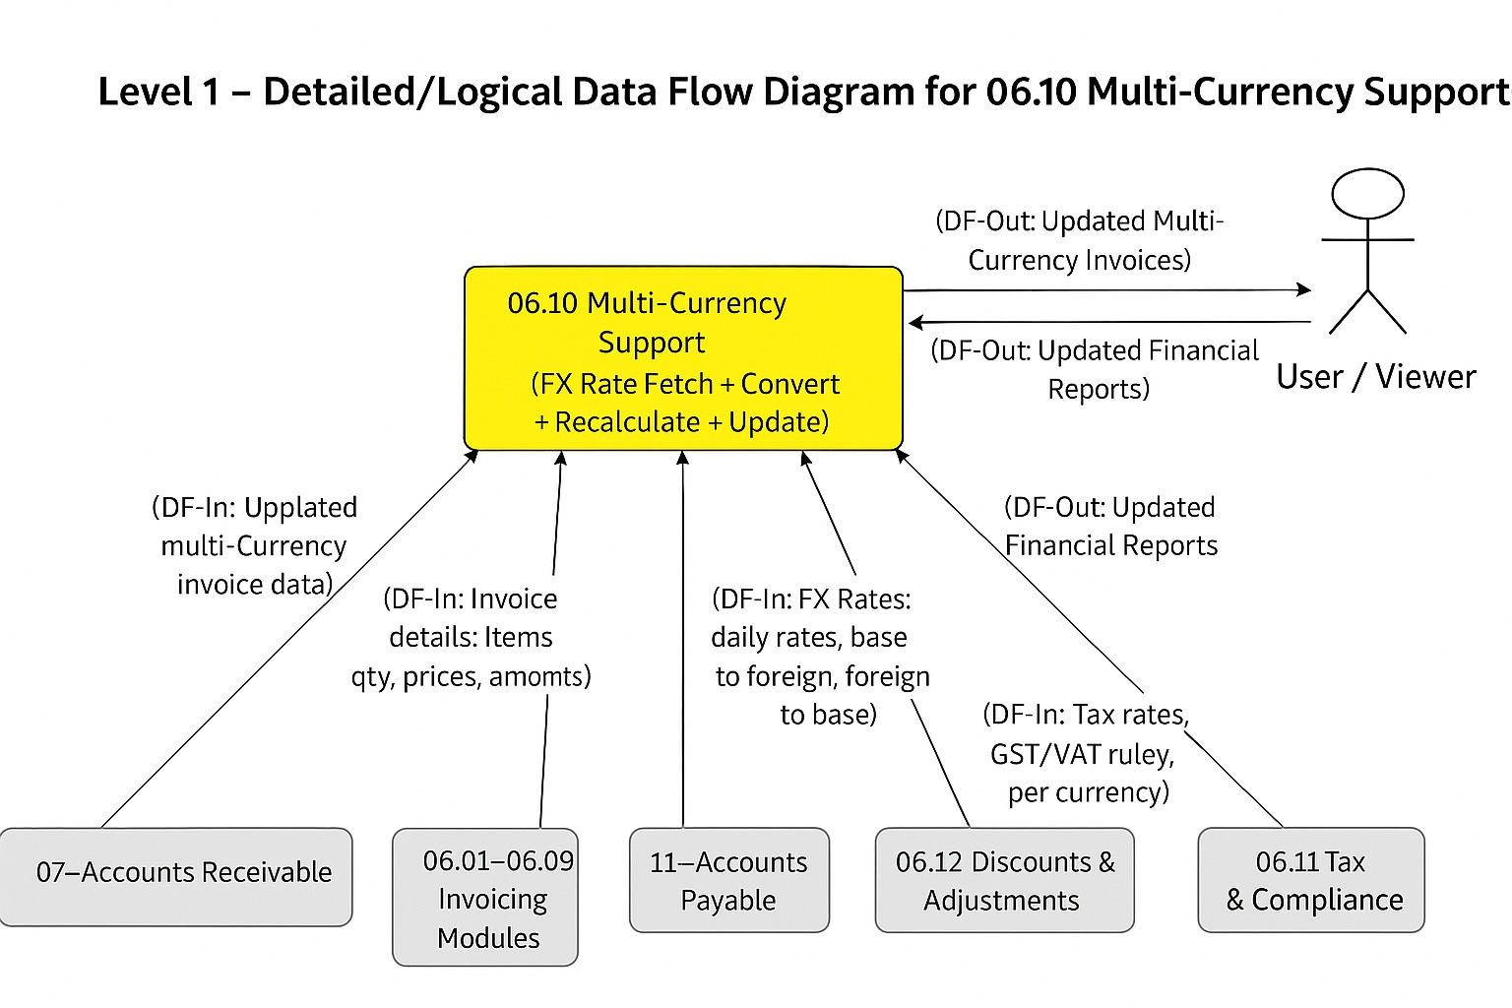

Slide 9
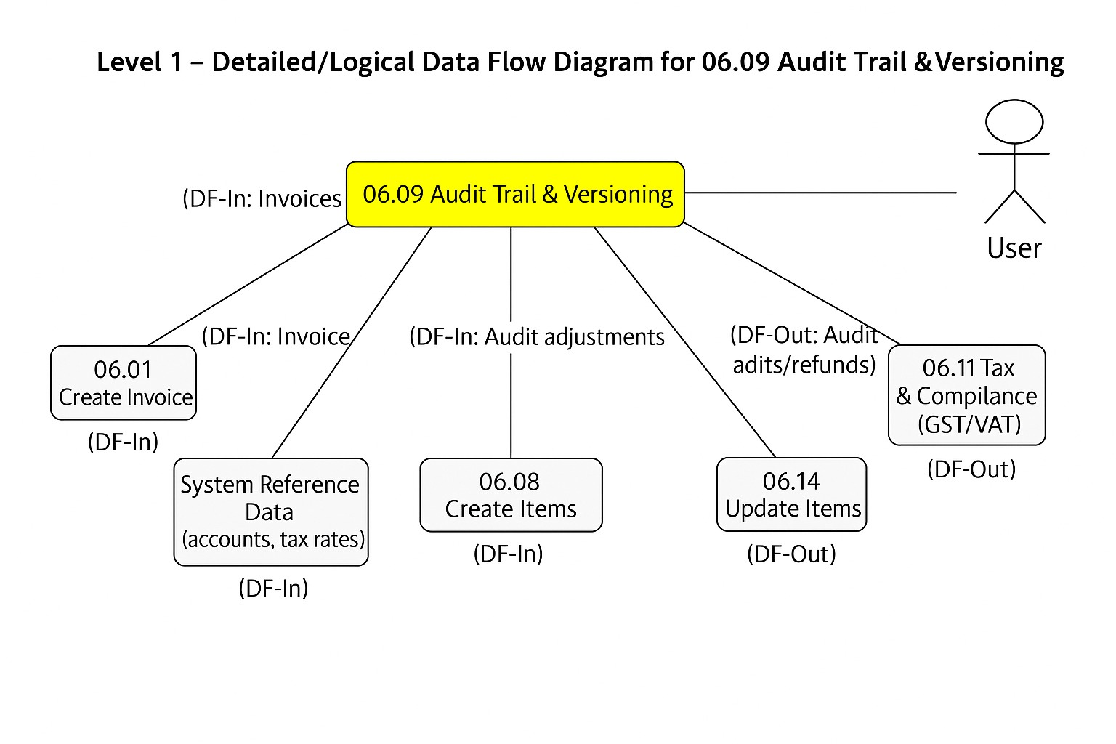

Slide 10
